Slide 1

UIDAI Aadhaar Enrolment Data Analysis
UIDAI Data Hackathon | Team ID: UIDAI_5246

Slide 2

PROBLEM STATEMENT
Understanding Enrolment Patterns for Policy Planning
Analytical Objectives
Strategic Importance
Our analysis examines Aadhaar enrolment data to identify state-wise distribution patterns, age-group demographics, and temporal trends. Understanding these patterns is essential for effective resource allocation and strategic planning.
Data-driven insights enable UIDAI and government agencies to make informed policy decisions, identify underserved regions, and optimize enrolment campaigns. This analysis serves as a foundation for evidence-based governance.

Slide 3

DATASET
UIDAI Aadhaar Enrolment Dataset Overview
Data Source
Key Fields
Aggregated, anonymized government data from official UIDAI repositories
Enrolment date, state, district, age-group classifications, and enrolment counts
Data Structure
Multiple CSV files consolidated into a unified master dataset for analysis

Slide 4





Tools & Technologies Employed
Microsoft Excel
Data Cleaning
Primary platform for data analysis, consolidation, and visualization throughout the project lifecycle
Systematic validation and standardization processes to ensure data quality and consistency
Pivot Analysis
Interactive Slicers
Advanced pivot tables and charts for multidimensional analysis and trend identification
Dynamic filtering mechanisms enabling real-time data exploration and segmentation

Slide 5
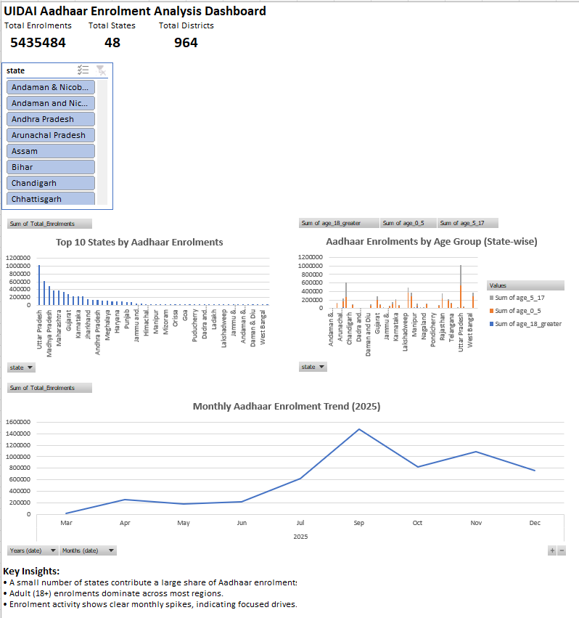

VISUALIZATION
Interactive Dashboard Solution
The dashboard integrates pivot charts,
trend lines, and multi-dimensional
slicers to facilitate comprehensive
analysis. Users can instantly drill
down into specific
regions, demographics,
or time periods to uncover actionable
intelligence.

Slide 6





DATA QUALITY
Data Preparation & Cleaning Process
Data Validation
Dataset Consolidation
Identified and removed invalid entries, duplicate records, and inconsistent data points
Merged multiple enrolment CSV files into a single comprehensive master dataset
Verification
Standardization
Validated totals and cross-checked aggregations to ensure analytical accuracy
Normalized state and district names to ensure uniformity across all records

Slide 7
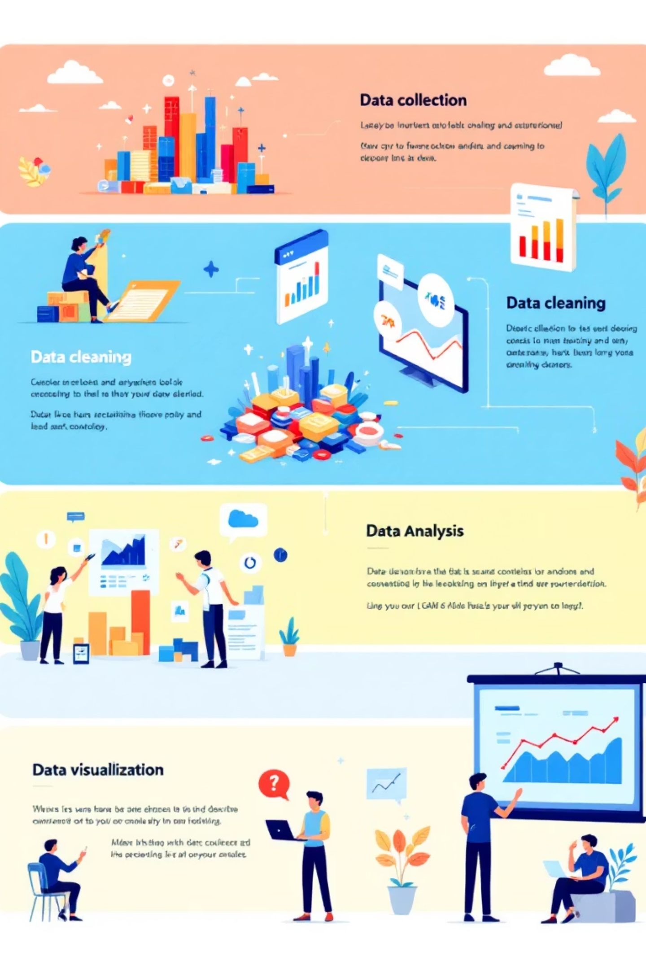
Analytical Methodology
1
1
State-wise Analysis
Temporal Trends
Examined enrolment distribution across Indian states to identify regional patterns
Tracked monthly enrolment patterns throughout 2025 to identify seasonal variations
2
2
Age-group Segmentation
Interactive Dashboard
Analyzed demographics across three categories: 0–5 years, 5–17 years, and 18+ years
Created dynamic visualization with slicers for multi-dimensional data exploration

Slide 8





INSIGHTS
Key Findings from Data Analysis
Regional Concentration
Adult Dominance
A small subset of high-population states accounts for a disproportionately large share of total Aadhaar enrolments across India
Adults aged 18 and above represent the majority of enrolments in most regions, with significant implications for campaign targeting
Seasonal Spikes
Geographic Variation
Specific months demonstrate sharp enrolment increases, indicating the impact of focused government enrolment drives and awareness campaigns
Substantial disparities exist across states and age groups, highlighting opportunities for targeted intervention strategies

Slide 9





Impact & Use Case Applications
Policy Planning
Identifies high-performing and underserved regions, enabling strategic resource allocation
Campaign Optimization
Supports design of targeted enrolment campaigns in specific demographics and geographies
Performance Monitoring
Enables continuous tracking of enrolment trends and program effectiveness over time
Data-Driven Governance
Demonstrates the transformative value of evidence-based decision-making in public administration

Slide 10

Conclusion & Way Forward
Summary of Findings
Our analysis reveals critical patterns in Aadhaar enrolment across states, age groups, and time periods. These insights provide a foundation for strategic planning and targeted interventions.
Value of Dashboard Analytics
Interactive dashboards transform raw government data into actionable intelligence, enabling real-time decision support for public policy initiatives.
Thank You
UIDAI Data Hackathon | Team ID: UIDAI_5246
This analysis demonstrates the power of data-driven governance in advancing digital identity initiatives for all citizens of India.

